Slide 1
How to run a normalization rule on a set of holdings records
and move everything inside angled brackets of 852 subfield h to 852 subfield k
Yoel Kortick
Senior Librarian

Slide 2
Agenda
Introduction
The normalization rule
The normalization rule and process
Creating a set to run the normalization process on
Run the job "Change holdings information"
The results of the job "Change holdings information"
2

Slide 3
Introduction

Slide 4
Introduction
In this presentation we will answer a real use case question from an Alma institution.
In doing so we will cover two topics:
  How to formulate the syntax of a normalization rule for a specific case
  How to run a normalization rule on a set of holdings records.

Slide 5
Introduction
From an Alma institution (part 1 of 2):
For historical reasons we have many holdings records with the call number prefix (subfield k) included as part of subfield h and inside greater than less than signs. For example:
8520_ $$b ULINC $$c GEN $$h <Ref> GT3405 $$i .A23 2019
8520_ $$b ULINC $$c GEN $$h <Vid> KF8858 $$i .P87 1992
8520_ $$b ULINC $$c GEN $$h <Oversize> T59.7 $$i .A37 2020

Slide 6
Introduction
From an Alma institution (part 2 of 2):
How can we change all of these to put the contents of the <> into subfield k, so it will be like this:
8520_ $$b ULINC $$c GEN $$k Ref $$h GT3405 $$i .A23 2019
8520_ $$b ULINC $$c GEN $$k Vid $$h KF8858 $$i .P87 1992
8520_ $$b ULINC $$c GEN $$k Oversize $$h T59.7 $$i .A37 2020

Slide 7
The normalization rule

Slide 8
The normalization rule
While there are many ways that this rule can be done, we will do as follows assuming that the list of prefixes is a closed list. This rule will handle the three prefixes which appear in the examples you provided:
<Ref>
<Oversize>
<Vid>
If there are more prefixes, then they too can be added to the list.

Slide 9
The normalization rule
rule "01 Move all contents in angled brackets of subfield h to subfield k"
when
# check to see if <Vid> exists at beginning of 852 subfield h and continue only if it does
(exists "852.h.<Vid>*")
then
# Remove <Vid> from 852 subfield h
replaceContents "852.h.<Vid>" with ""
# Add subfield k with Vid
addSubField "852.k.Vid"
end
rule "02 Move all contents in angled brackets of subfield h to subfield k"
when
# check to see if <Ref> exists at beginning of 852 subfield h and continue only if it does
(exists "852.h.<Ref>*")
then
# Remove <Ref> from 852 subfield h
replaceContents "852.h.<Ref>" with ""
# Add subfield k with Ref
addSubField "852.k.Ref"
end
rule "03 Move all contents in angled brackets of subfield h to subfield k"
when
# check to see if <Oversize> exists at beginning of 852 subfield h and continue only if it does
(exists "852.h.<Oversize>*")
then
# Remove <Oversize> from 852 subfield h
replaceContents "852.h.<Oversize>" with ""
# Add subfield k with Oversize
addSubField "852.k.Oversize"
end
This is the normalization rule.
Comments in yellow explain what the rule does

Slide 10
The normalization rule and process

Slide 11
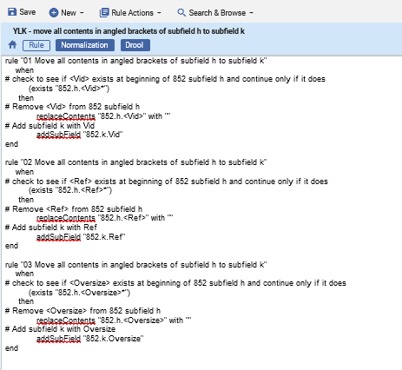
The normalization rule and process
Here is the normalization rule.
It is called “YLK - move all contents in angled brackets of subfield h to subfield k”

Slide 12
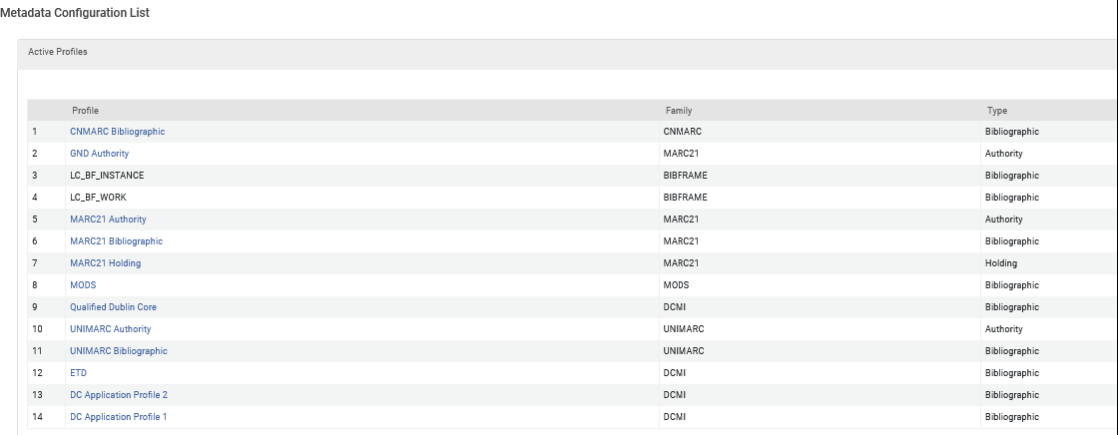
The normalization rule and process
The normalization process should be created for the MARC21 Holding profile.
This is accessed at “Configuration > Resources > Cataloging > Metadata Configuration > MARC21 Holding”

Slide 13
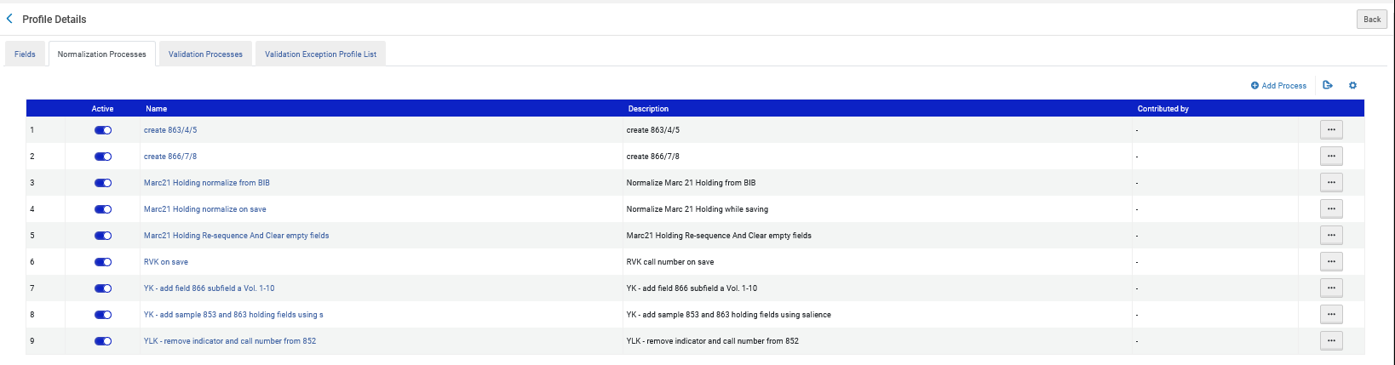
The normalization rule and process
From the “Normalization Processes” tab we will click “Add Process”

Slide 14
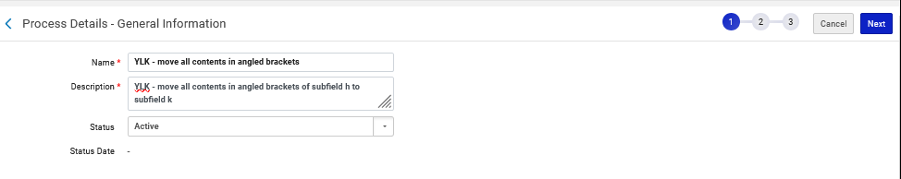
The normalization rule and process
Give it a name and description and click “Next”.
We gave it name “YLK - move all contents in angled brackets”
We gave it description “YLK - move all contents in angled brackets of subfield h to subfield k“ (which is the same as the name of the normalization rule, but it is not necessary to give the description the same name as the normalization rule)

Slide 15
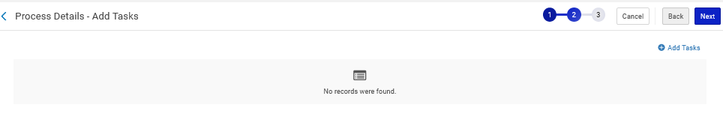
The normalization rule and process
Add a task

Slide 16
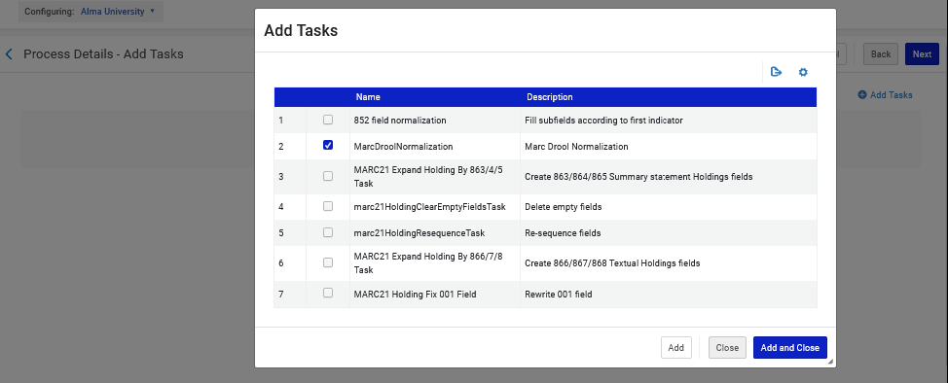
The normalization rule and process
Choose “MARC Drool Normalization” and click “Add and Close”
Because we chose “MARC Drool Normalization” we will soon also choose the corresponding normalization rule for the normalization process.

Slide 17
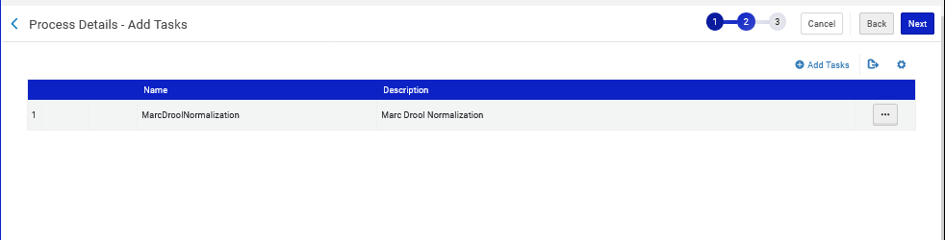
The normalization rule and process
Click “Next”

Slide 18
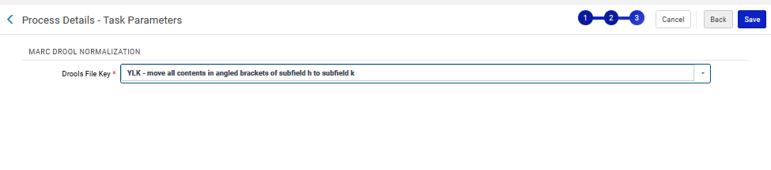
The normalization rule and process
Choose the Normalization Rule which will be run in this Normalization Process and click “Save”.
The reason we now can choose a Normalization Rule is because previously we chose MarcDroolNormalization as a task
This is the Normalization Rule we previously saw

Slide 19
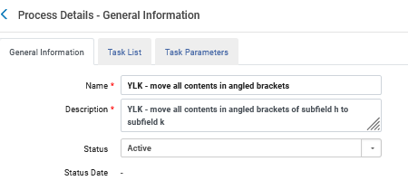
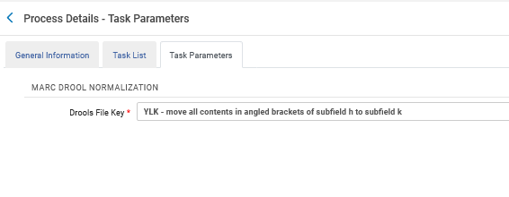
The normalization rule and process
The Normalization Process has been made.
The Normalization Process named “YLK - move all contents in angled brackets” uses Normalization Rule named “YLK - move all contents in angled brackets of subfield h to subfield k”

Slide 20
Creating a set to run the normalization process on

Slide 21
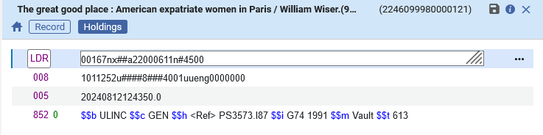
Creating a set to run the normalization process on
Title “Running the normalization process on a set” MMSID 99210811300121 has holdings record MMSID 2246099980000121
Example one of three

Slide 22
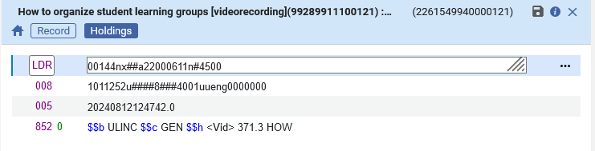
Creating a set to run the normalization process on
Title “How to organize student learning groups” MMSID 99289911100121 has holdings record MMSID 2261549940000121
Example two of three

Slide 23
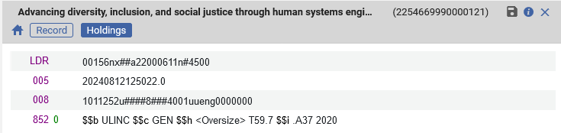
Creating a set to run the normalization process on
Title “Advancing diversity, inclusion, and social justice through human systems engineering” MMSID 99251611300121 has holdings record MMSID 2254669990000121
Example three of three

Slide 24
Creating a set to run the normalization process on
Now we will perform a “Physical Holdings” advanced search as follows to retrieve these holdings records:
Where (
Permanent call number Contains exact phrase starting with "<Oversize>"
or
Permanent call number Contains exact phrase starting with "<Ref>"
or
Permanent call number Contains exact phrase starting with "<Vid>“
)

Slide 25
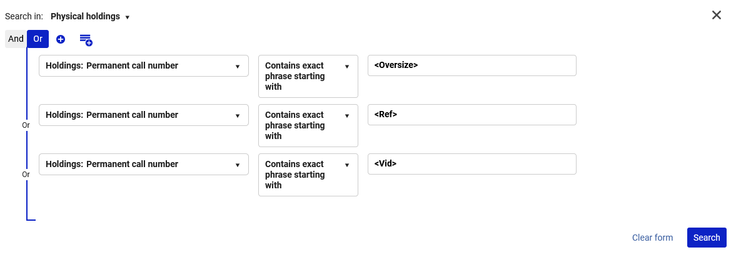
Creating a set to run the normalization process on
Here is the search:

Slide 26
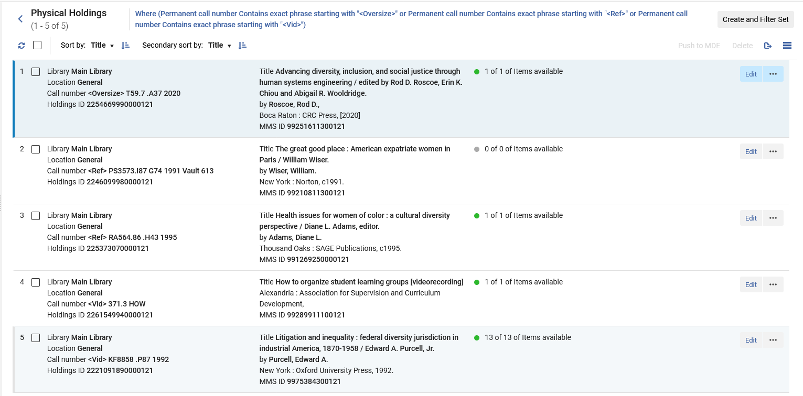
Creating a set to run the normalization process on
We have five results and will save as a set

Slide 27
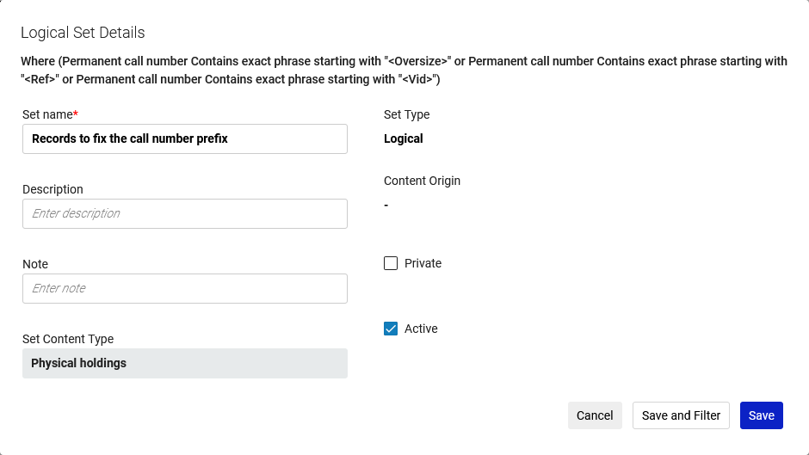
Creating a set to run the normalization process on
The set is called “Records to fix the call number prefix”

Slide 28
Run the job "Change holdings information"

Slide 29
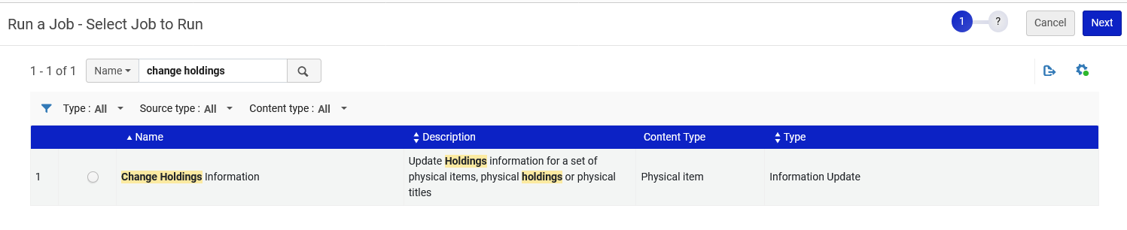
Run the job "Change holdings information"
Now we will Run the job "Change holdings information" to update the holdings records.
The job is accessed at “Admin > Manage Jobs and Sets > Run a Job.”

Slide 30
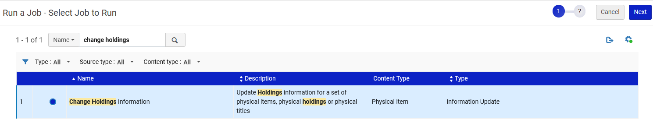
Run the job "Change holdings information"
We will run the job

Slide 31
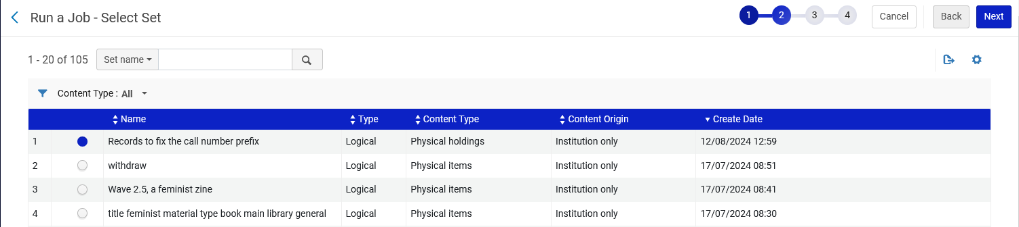
Run the job "Change holdings information"
We choose the set

Slide 32
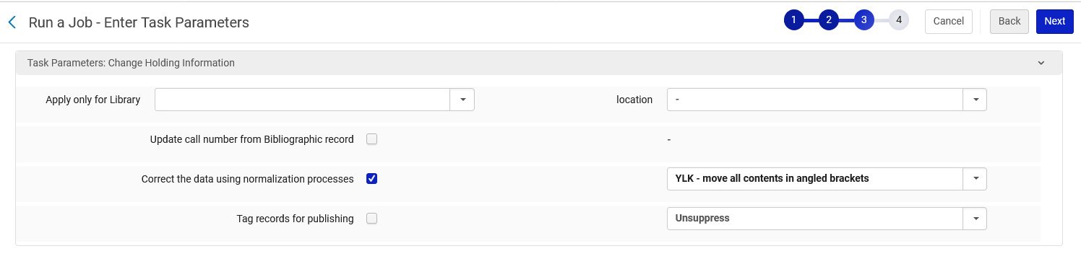
Run the job "Change holdings information"
We choose the normalization process which we made earlier

Slide 33
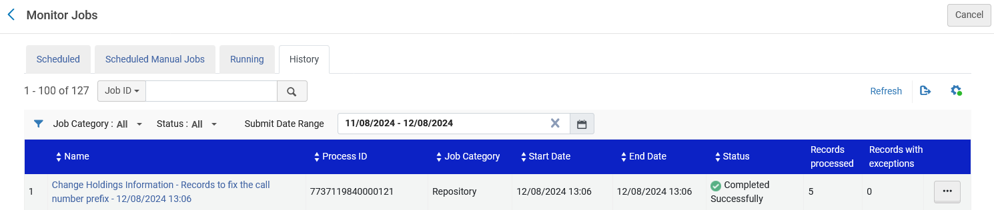
Run the job "Change holdings information"
The job completes

Slide 34
The results of the job "Change holdings information"

Slide 35
The results of the job "Change holdings information"
Let’s now look at three examples we previously saw.
As we will see everything worked perfectly.

Slide 36
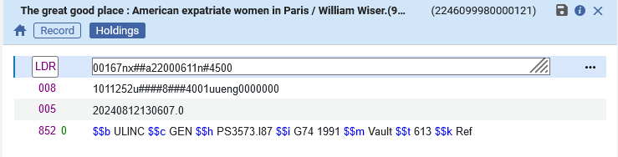
The results of the job "Change holdings information"
Title “Running the normalization process on a set” MMSID 99210811300121 has holdings record MMSID 2246099980000121
Example one of three
Before
After

Slide 37
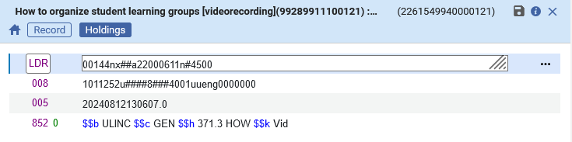
The results of the job "Change holdings information"
Title “How to organize student learning groups” MMSID 99289911100121 has holdings record MMSID 2261549940000121
Example two of three
Before
After

Slide 38
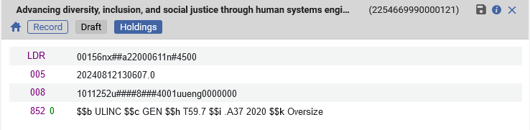
The results of the job "Change holdings information"
Title “Advancing diversity, inclusion, and social justice through human systems engineering” MMSID 99251611300121 has holdings record MMSID 2254669990000121
Example three of three
Before
After

Slide 39
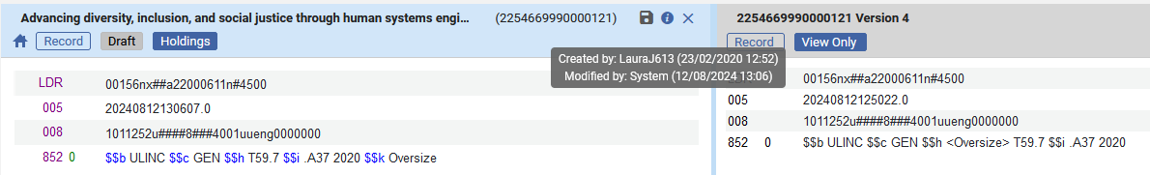
The results of the job "Change holdings information"
In the Metadata Editor we can
See that the record was updated by “System” (the job)
Do “View related Information > View Versions” to see the specific change

Slide 40
Thank You

